Slide 1

PRIME PATHWY SOVEREIGN SYSTEM
Manus Master Credit Maximization System
10–20 Year Institutional Intelligence Architecture
Arthur F. Appling Sr. · Lead Technical Architect
May 2026

Slide 2

Every Credit Must Produce Permanent Infrastructure — Not Temporary Output
The Manus Master System is built on a single governing principle: institutional memory compounds. Tools will change. Models will change. Platforms will change. But documented systems, indexed intelligence, SOPs, recovery procedures, and governance frameworks continue delivering operational leverage for decades. This system converts AI credits into permanent business infrastructure across five sovereign domains.
DO NOT USE FOR
DO USE FOR
Random experiments
Structured institutional intelligence
Generic brainstorming
Permanent operating systems
Motivational content
Indexed knowledge bases
Shallow summaries
SOP generation & recovery systems
Duplicated internet research
Legal, compliance & automation structures

Slide 3

The WAT Framework Is the Structural Law of the Prime Pathwy Ecosystem
All outputs generated by this system are organized under the WAT Framework — the non-negotiable file governance standard for Prime Pathwy operations. Temporary data is isolated to prevent contamination of the permanent record.
WORKFLOWS
AGENTS
/workflows
/agents
Step-by-step execution procedures (.md). Defines the operational logic and validation contracts.
AI prompt instructions (.md). The cognitive engine driving the execution of specific tasks.
TOOLS
TEMPORARY
/tools
/temporary
Python scripts and automation code (.py). The mechanical execution layer of the sovereign system.
Staging data, ephemeral outputs. Isolated to protect the integrity of the permanent institutional vault.

Slide 4
WF-01 Is the Central Intelligence Repository That All Other Workflows Feed Into
The Institutional Knowledge Vault is the system's core: a durable folder and doc structure designed to persist through decades of change.
CORE OUTPUTS
MASTER_INDEX.md
It produces searchable intelligence—markdown, CSVs, JSON, maps, and escalation trees—for contracting, real estate, AI, finance, and crisis response.
KNOWLEDGE_TREE.md
ARCHIVE_MANIFEST.md
OPERATIONAL_LAWS.md
WF-04 feeds contracting intelligence. WF-05 logs daily operations. WF-03 archives recovery data.

Slide 5
WF-02 Converts the Knowledge Vault Into a 12-Month Operator Mastery Curriculum
The Operator Training System is the human capital layer of the sovereign ecosystem. It structures a complete beginner-to-advanced curriculum across four phases designed for an operator with strong vision but limited traditional engineering experience. Each phase includes daily repetition drills, command memorization, recovery simulations, and real-world operational walkthroughs.
01
02
03
04
BEGINNER
INTERMEDIATE
ADVANCED
INSTITUTIONAL
Foundational concepts, terminal basics, and daily repetition drills.
Command memorization, GitHub navigation, and basic troubleshooting.
Recovery simulations, operational walkthroughs, and database management.
Full sovereign mastery, emergency response, and system architecture.

Slide 6
WF-03 Ensures No Single Failure Can Collapse the Sovereign System
The Enterprise Failure Recovery System is the defensive architecture of Prime Pathwy. It builds recovery playbooks for every critical failure mode. Every playbook documents symptoms, causes, severity level, recovery steps, rollback commands, validation steps, and prevention methods.
CRITICAL FAILURE MODES
SYSTEM DELIVERABLES
Git conflicts & corrupted branches
Emergency Operations Manual
Database corruption & lock issues
System Integrity Verification Checklist
Broken APIs & failed deployments
Maintenance Routines
Docker & infrastructure failures
"DO NOT TOUCH" Zones
AI hallucination damage
Establishes protected database rules, branch protection rules, and backup protection rules. WF-03 directly informs WF-05 by supplying the discipline rules that govern daily operations.
Accidental file overwrites

Slide 7
WF-04 Converts Institutional Intelligence Into $5,000+ Sovereign System Revenue
The Government Contracting Intelligence Engine is the primary capital acquisition workflow. It builds a permanent intelligence structure targeting California procurement, Northern California municipalities, SAM.gov, SBA programs, CalOSBA, BAAQMD, PlanetBids, and OpenGov. It generates RFP trackers, bid scoring systems, contract qualification systems, and AI-assisted workflows for summarizing RFPs, extracting requirements, generating proposal drafts, and performing compliance analysis. All intelligence flows directly into WF-01 to populate the knowledge vault, creating a compounding intelligence loop that improves every future bid.
TARGET SYSTEMS
SAM.gov
PlanetBids
CalOSBA
OpenGov
SBA
BAAQMD

Slide 8
WF-05 Governs Every Hour of the Operator's Day With Institutional Discipline
The Personal Sovereign Operating System is the command layer that ties all other workflows together. It structures the operator's daily rhythm through morning startup procedures, operational review procedures, and evening shutdown procedures. It enforces AI delegation rules, verification laws, audit laws, and execution discipline systems. Anti-chaos, anti-overload, and anti-context-scramble systems prevent operational drift. WF-05 logs all daily operations back into WF-01, ensuring the knowledge vault remains current. It is designed for one operator, low overhead, high leverage, and long-term survivability.
MORNING STARTUP
OPERATIONAL REVIEW
EXECUTION PHASE
EVENING SHUTDOWN
WEEKLY / MONTHLY REVIEW
→
→
→
→

Slide 9
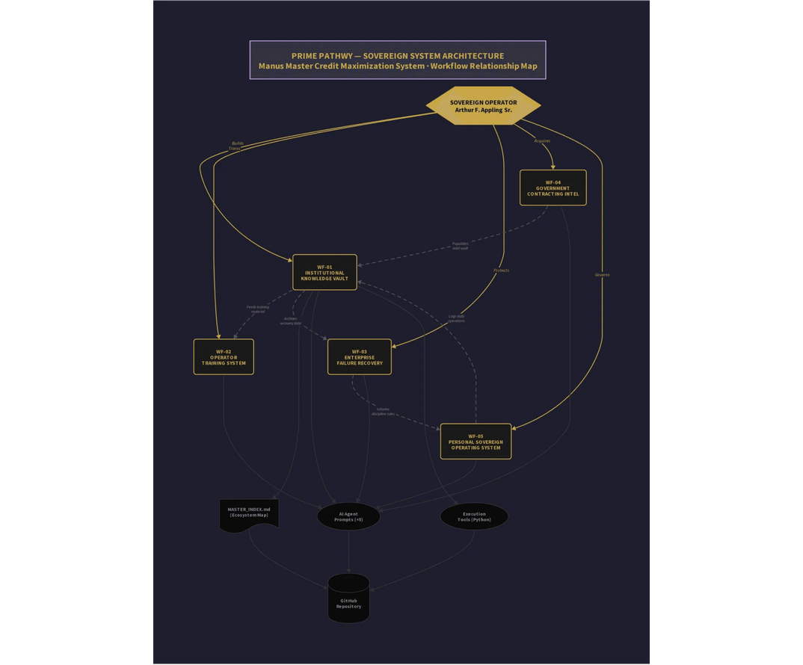
The Five Workflows Form a Self-Reinforcing Sovereign Intelligence Loop
The five workflows are not independent — they form a closed-loop system. The Sovereign Operator sits at the apex, directing all five workflows.
WF-01 (Knowledge Vault) is the central hub: WF-04 populates it with contracting intelligence, WF-05 logs daily operations into it, and WF-03 archives recovery data within it.
WF-01 feeds training material into WF-02. WF-03 informs the discipline rules of WF-05. All five workflows produce Agent Prompts and Execution Tools, which are indexed in the MASTER_INDEX and pushed to the GitHub repository.

Slide 10

The Real Asset Is Not the AI Tool — It Is the Institutional Memory You Build With It
The long-term value of this system is not dependent on any single AI platform, model, or tool. It is the documented systems, operational discipline, indexed intelligence, SOPs, recovery systems, governance frameworks, architecture, and training systems that compound in value over decades. Every workflow, agent, and tool generated today becomes a permanent operational asset that future contractors, employees, vendors, and AI systems can reference, execute, and build upon. This is the Prime Pathwy doctrine: Systems over Labor. Documentation over Assumption. Institutional Memory over Temporary Output.
ASSET TYPE
1-YEAR VALUE
10-YEAR VALUE
Documented Workflows
Operational clarity
Institutional standard
Agent Prompts
Immediate AI leverage
Reusable across all future AI platforms
Recovery Playbooks
Prevents downtime
Trains future operators
Gov Contracting Intel
First bids
Compounding bid win rate
Sovereign OS
Daily discipline
Scalable enterprise structure

Slide 11
Three Execution Actions Required to Activate the Sovereign System
The system is staged and ready. Three actions must be completed to bring it fully online. First, review and merge Pull Request #26 on the arthurappling-ISE-DYNAMICE GitHub repository. Second, execute the five Agent Prompts sequentially. Third, activate the WF-05 Personal Sovereign Operating System.
01
MERGE PR #26 ON GITHUB
github.com → arthurappling-ISE-DYNAMICE → PR #26 → Merge
02
EXECUTE AGENT PROMPTS IN SEQUENCE
Start with: agents/01_institutional_knowledge_vault_agent.md
03
ACTIVATE DAILY SOVEREIGN OS
Run: tools/execute_workflow.py workflows/05_personal_sovereign_operating_system.md

